Slide 1
How Neural Networks Shape the Manifold Hypothesis?
Henrique Ennes
Professor Renato Rocha
Redes Neurais e Deep Learning
08/10/2021

Slide 2
What are manifolds?
Manifolds are “figures” that look like some $ℝ^{n}$ in small patches

Slide 3
What are manifolds?
Manifolds are “figures” that look like some $ℝ^{n}$ in small patches

Slide 4
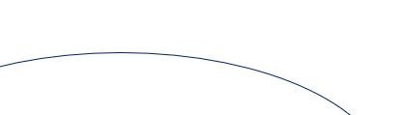
What are manifolds?
Manifolds are “figures” that look like some $ℝ^{n}$ in small patches

Slide 5
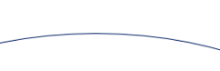
What are manifolds?
Manifolds are “figures” that look like some $ℝ^{n}$ in small patches

Slide 6

What are manifolds?
Manifolds are “figures” that look like some $ℝ^{n}$ in small patches

Slide 7

What are manifolds?
Manifolds are “figures” that look like some $ℝ^{n}$ in small patches

Slide 8

What are manifolds?
Manifolds are “figures” that look like some $ℝ^{n}$ in small patches

Slide 9

What are manifolds?
What about flat Earth?
Manifolds are “figures” that look like some $ℝ^{n}$ in small patches

Slide 10
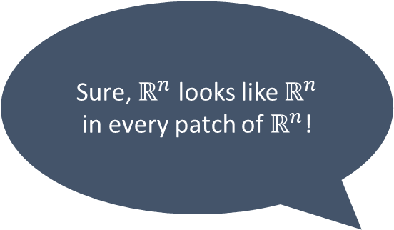
What are manifolds?
Sure, $ℝ^{n}$ looks like $ℝ^{n}$ in every patch of $ℝ^{n}$!
Manifolds are “figures” that look like some $ℝ^{n}$ in small patches

Slide 11
How do we study manifolds?
Geometry

Slide 12
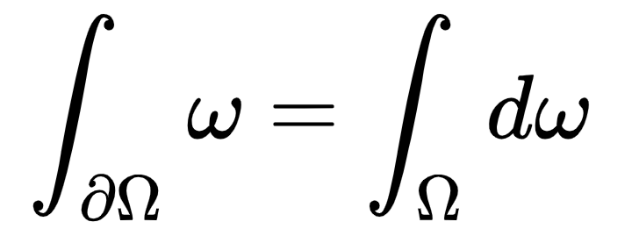

How do we study manifolds?
Geometry

Slide 13
How do we study manifolds?
Geometry = things are equal all lengths agree

Slide 14
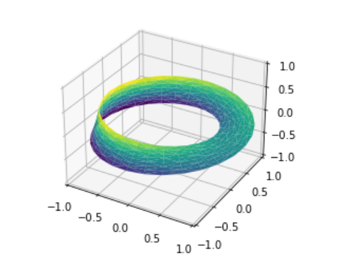
How do we study manifolds?
Topology [1]

Slide 15
How do we study manifolds?
Topology [1]
Cannot even talk about areas!

Slide 16
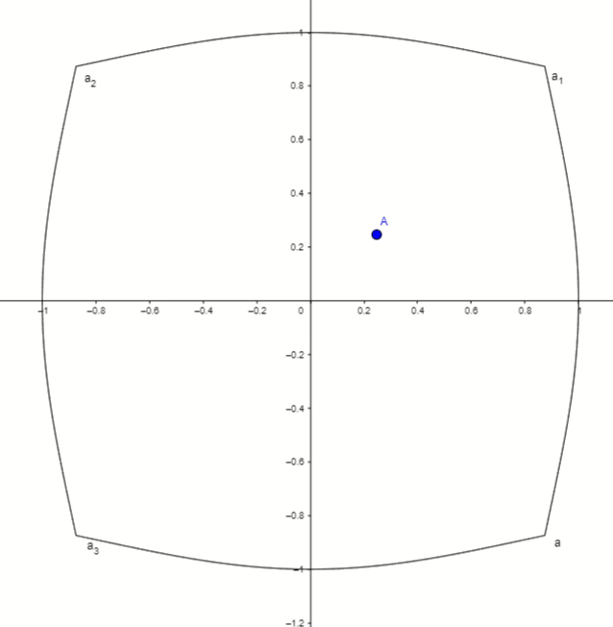
How do we study manifolds?
Topology = things are equal if they can continuously deform into one another [2]

Slide 17
How do we study manifolds?
Geometrically
=

Slide 18
How do we study manifolds?
Topologically
=

Slide 19
How do we study manifolds?
Topologically
=

Slide 20
How do we study manifolds?
Topologically
=

Slide 21
How do we study manifolds?
Topologically
=

Slide 22
How do we study manifolds?
Topologically
≠

Slide 23
How do we study manifolds?
0 holes
Topologically
≠

Slide 24
How do we study manifolds?
0 holes
Topologically
≠
1 hole

Slide 25
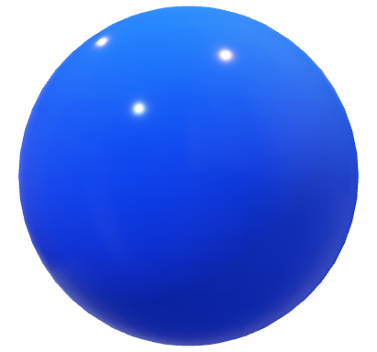
How do we study manifolds?
Topologically
≠

Slide 26
How do we study manifolds?
1 1d hole
0 2d holes
Topologically
≠

Slide 27
How do we study manifolds?
1 1d hole
0 2d holes
Topologically
≠
0 1d holes
1 2d hole

Slide 28
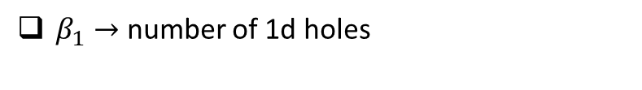
How do we study manifolds?
Betti Numbers
$β_{1}→$ number of 1d holes

Slide 29
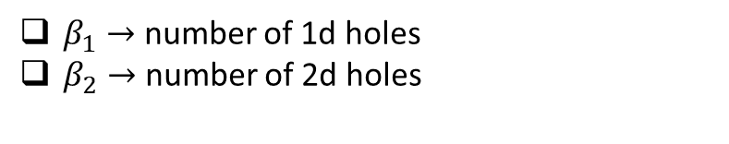
How do we study manifolds?
Betti Numbers
$β_{1}→$ number of 1d holes
$β_{2}→$ number of 2d holes

Slide 30
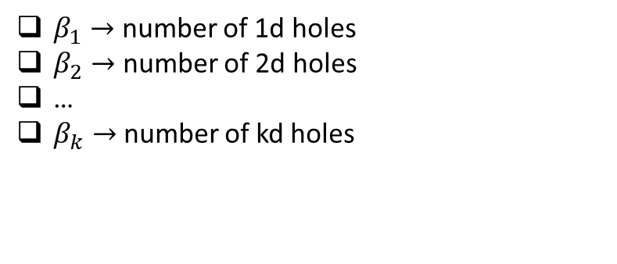
How do we study manifolds?
Betti Numbers
$β_{1}→$ number of 1d holes
$β_{2}→$ number of 2d holes
…
$β_{k}→$ number of kd holes

Slide 31
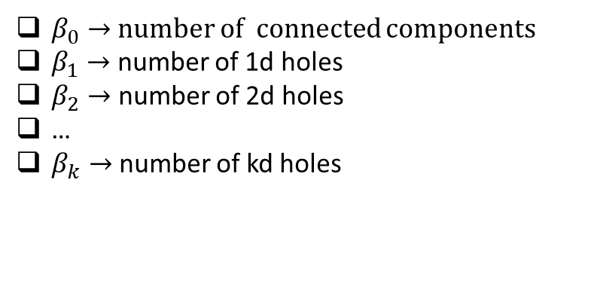
How do we study manifolds?
Betti Numbers
$β_{0}→$ number of connected components
$β_{1}→$ number of 1d holes
$β_{2}→$ number of 2d holes
…
$β_{k}→$ number of kd holes

Slide 32
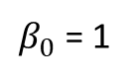
How do we study manifolds?
Betti Numbers
$β_{0}$ = 1
$β_{0}→$ number of connected components
$β_{1}→$ number of 1d holes
$β_{2}→$ number of 2d holes
…
$β_{k}→$ number of kd holes

Slide 33
How do we study manifolds?
Betti Numbers
$β_{0}$ = 1
$β_{0}→$ number of connected components
$β_{1}→$ number of 1d holes
$β_{2}→$ number of 2d holes
…
$β_{k}→$ number of kd holes

Slide 34
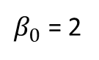
How do we study manifolds?
Betti Numbers
$β_{0}$ = 2
$β_{0}→$ number of connected components
$β_{1}→$ number of 1d holes
$β_{2}→$ number of 2d holes
…
$β_{k}→$ number of kd holes

Slide 35
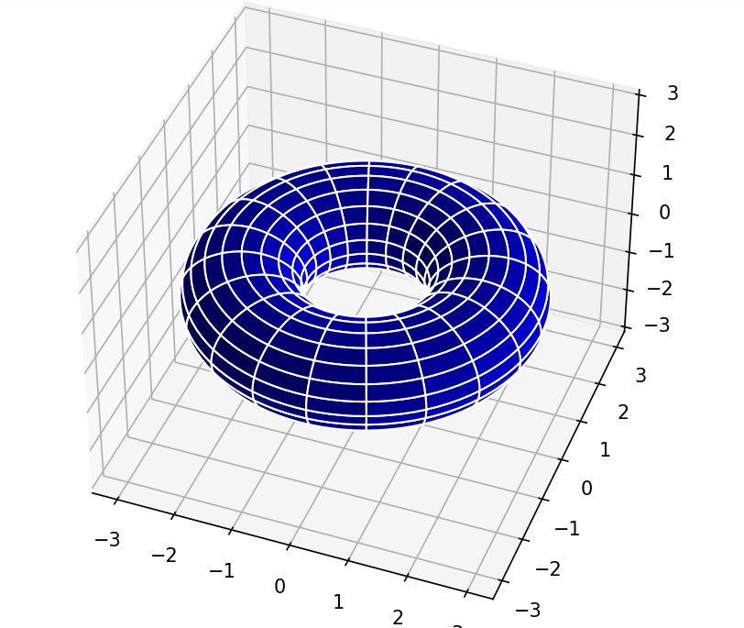
How do we study manifolds?
Betti Numbers

Slide 36
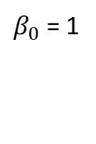
How do we study manifolds?
Betti Numbers
$β_{0}$ = 1

Slide 37
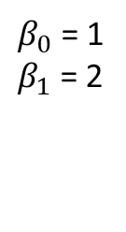
How do we study manifolds?
Betti Numbers
$β_{0}$ = 1
$β_{1}$ = 2

Slide 38
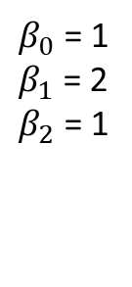
How do we study manifolds?
Betti Numbers
$β_{0}$ = 1
$β_{1}$ = 2
$β_{2}$ = 1

Slide 39
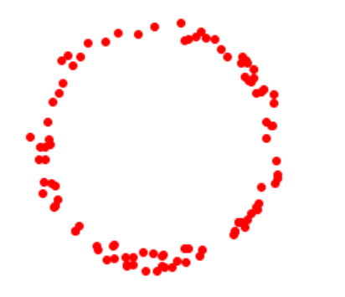
Why manifolds?
Datasets can lie close to manifolds

Slide 40
Why manifolds?
Datasets can lie close to manifolds

Slide 41
Why manifolds?
Datasets can lie close to manifolds $→$ allows for decreasing the dimension of the problem

Slide 42
Why manifolds?
Datasets can lie close to manifolds $→$ allows for decreasing the dimension of the problem
Classical manifold hypothesis: if learning in possible, it is because the dataset lies close to a manifold of smaller dimension

Slide 43
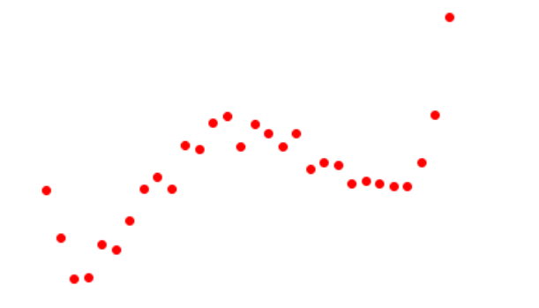
Why manifolds?

Slide 44
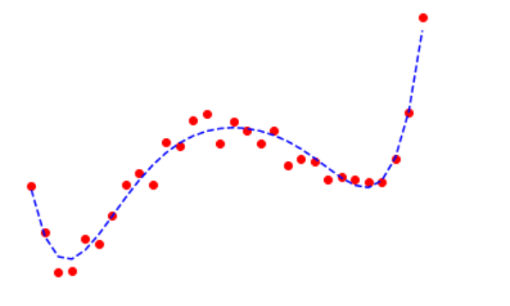
Why manifolds?

Slide 45
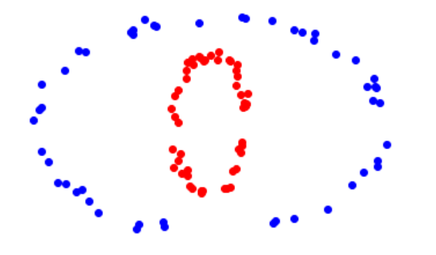
Why manifolds?

Slide 46
Why manifolds?

Slide 47
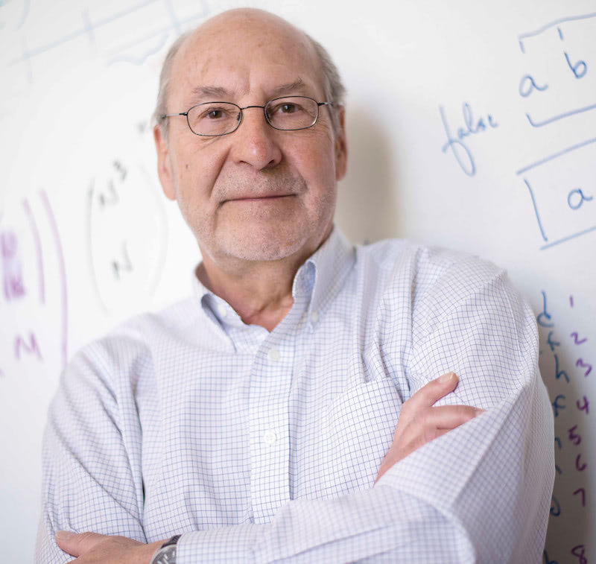
Why manifolds?
A two-layer neural network can approximate any manifold! [3]

Slide 48
Are we done?
Why do we need to go deeper if 2 layers is universal approximators? Is it not best to go wide?

Slide 49
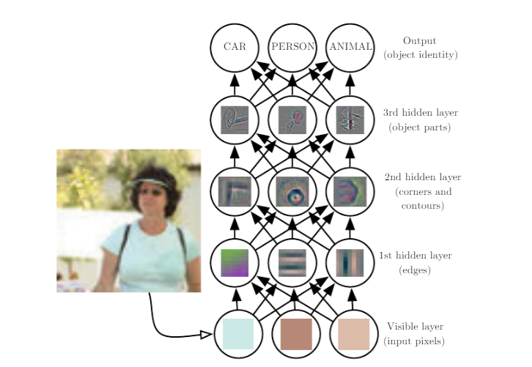
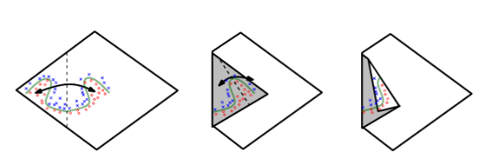
Are we done?
Why do we need to go deeper if 2 layers is universal approximators? Is it not best to go wide? [$4$] [5]

Slide 50

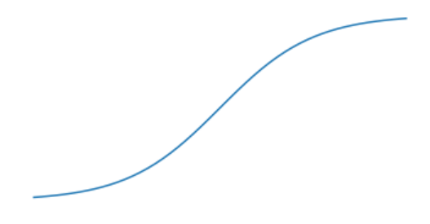
Are we done?
Why do we need to go deeper if 2 layers is universal approximators? Is it not best to go wide?
ReLUs tend to be better than hyperbolic tangent
tanh
ReLU

Slide 51
Are we done?
Why do we need to go deeper if 2 layers is universal approximators? Is it not best to go wide?
ReLUs tend to be better than hyperbolic tangent
tanh
ReLU

Slide 52
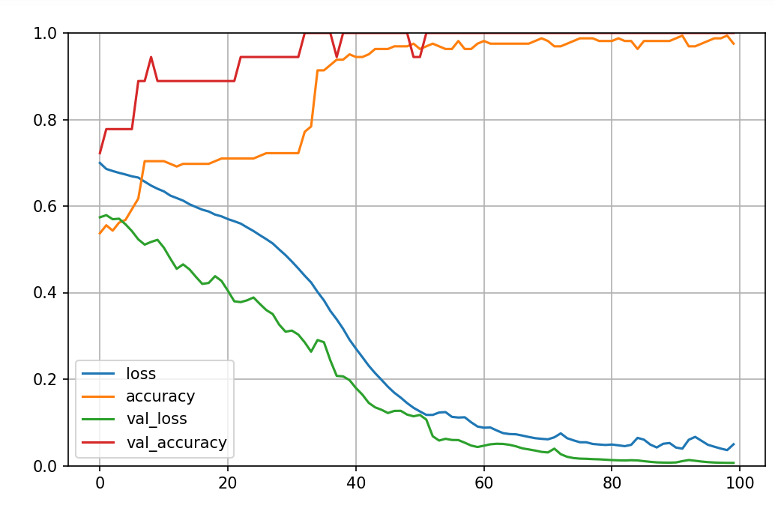
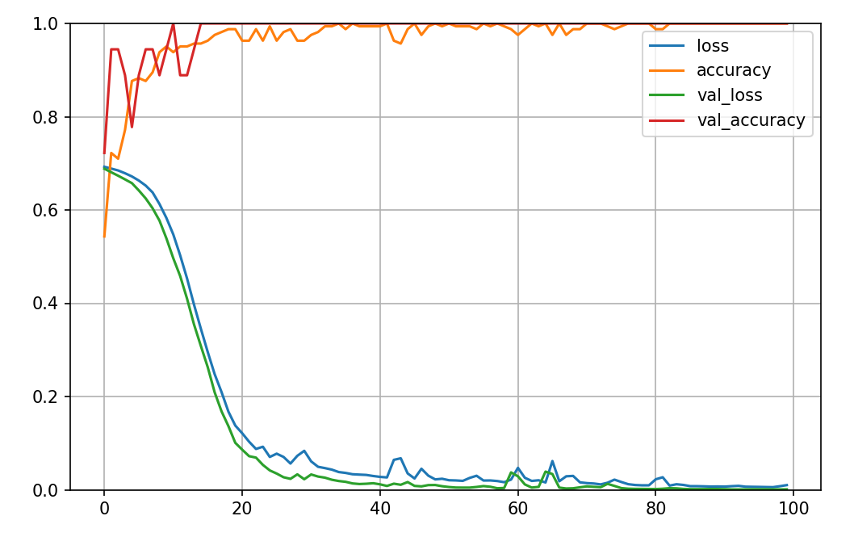
Are we done?
Why do we need to go deeper if 2 layers is universal approximators? Is it not best to go wide?
ReLUs tend to be better than hyperbolic tangent
tanh
ReLU

Slide 53
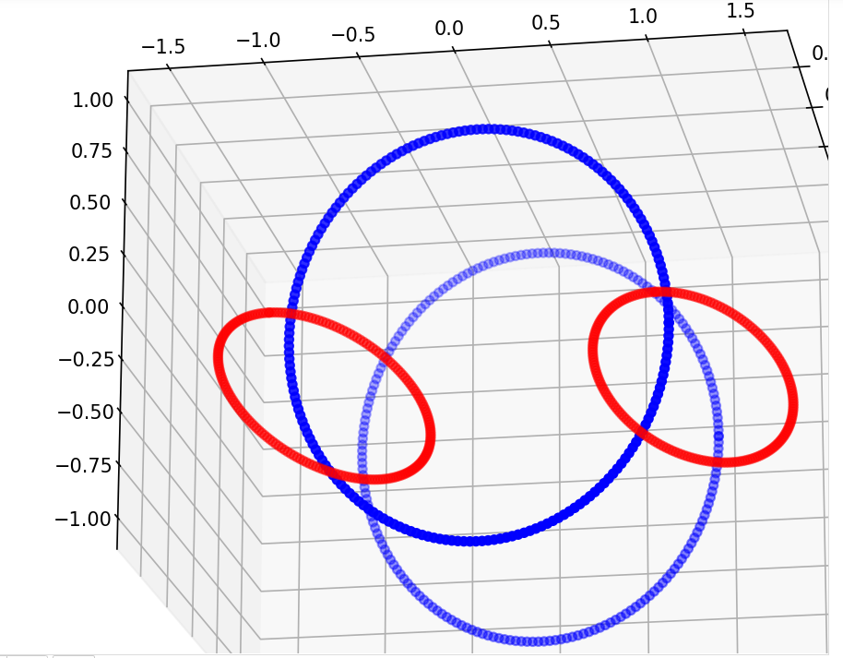
What is this new view?
Neural networks learn because, not only they reduce the dimensionality of the problem, but also the geometric and topological complexities [$6$]

Slide 54
What is this new view?
Neural networks learn because, not only they reduce the dimensionality of the problem, but also the geometric and topological complexities [$6$]
1 output
sigmoid
4 x (15 units hidden layers)
ReLU
3 inputs

Slide 55
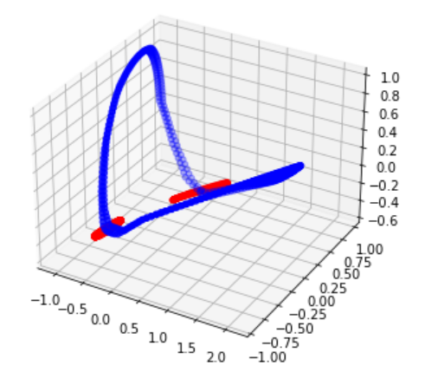
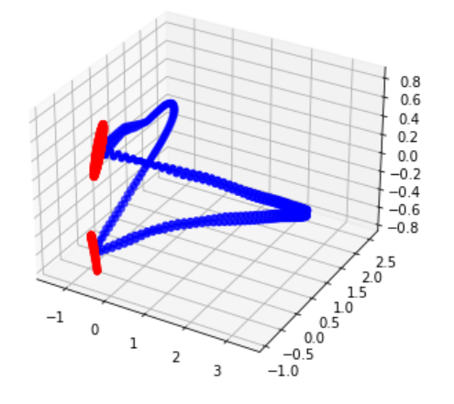
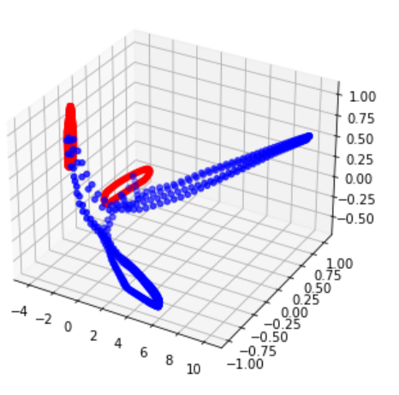
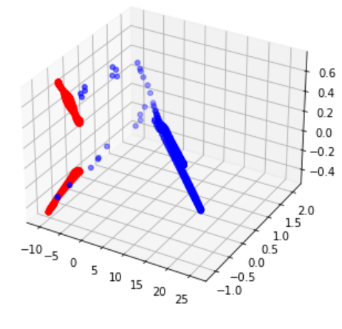
What is this new view?
Neural networks learn because, not only they reduce the dimensionality of the problem, but also the geometric and topological complexities [$6$]

Slide 56
What is this new view?
Neural networks learn because, not only they reduce the dimensionality of the problem, but also the geometric and topological complexities [$6$]

Slide 57
What is this new view?
Neural networks learn because, not only they reduce the dimensionality of the problem, but also the geometric and topological complexities [$6$]

Slide 58
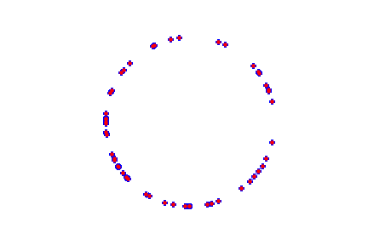
How to find the manifold?

Slide 59
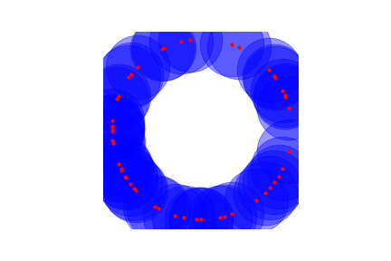
How to find the manifold?

Slide 60
How to find the manifold?
Geometrically, not the manifold,
only topologically

Slide 61
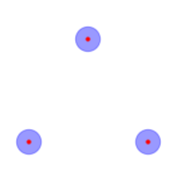
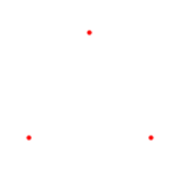
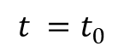
How to find the manifold?
$$t =t_{0}$$

Slide 62
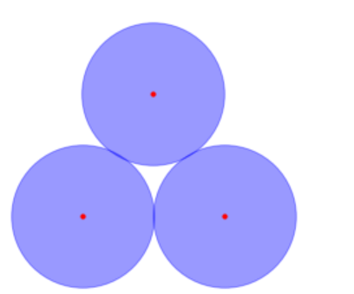
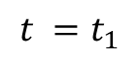
How to find the manifold?
$$t =t_{1}$$

Slide 63
How to find the manifold?
$$t =t_{1}$$

Slide 64
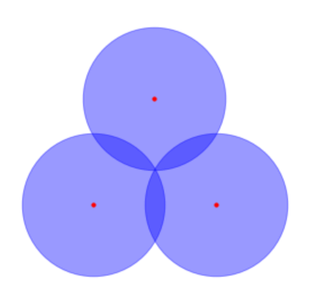
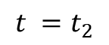
How to find the manifold?
$$t =t_{2}$$

Slide 65
How to find the manifold?
$$t =t_{2}$$

Slide 66
How to find the manifold?
So lived $t=t_{1}−t_{0}$

Slide 67
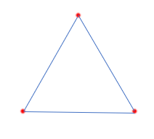
How to find the manifold?
So lived $t=t_{1}−t_{0}$
So lived $t=t_{2}−t_{1}$

Slide 68
How to find the manifold?
Not important as dies very early on
So lived $t=t_{1}−t_{0}$
So lived $t=t_{2}−t_{1}$

Slide 69
How to find the manifold?
Not important as it dies very early on
So lived $t=t_{1}−t_{0}$
So lived $t=t_{2}−t_{1}$
Important because it persists

Slide 70
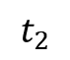
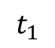
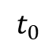
How to find the manifold?
So lived $t=t_{1}−t_{0}$
So lived $t=t_{2}−t_{1}$
$$t_{0}$$
$$t_{1}$$
$$t_{2}$$

Slide 71
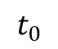
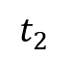
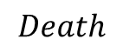
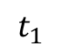
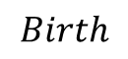



How to find the manifold?
So lived $t=t_{1}−t_{0}$
$$∞$$
$$t_{2}$$
So lived $t=t_{2}−t_{1}$
$$Death$$
$$t_{1}$$
$$t_{0}$$
$$Birth$$
$$t_{0}$$
$$t_{1}$$
$$t_{2}$$

Slide 72
How to find the manifold?
So lived $t=t_{1}−t_{0}$
$$∞$$
$$t_{2}$$
So lived $t=t_{2}−t_{1}$
$$Death$$
$$t_{1}$$
$$t_{0}$$
$$Birth$$
$$t_{0}$$
$$t_{1}$$
$$t_{2}$$

Slide 73
How to find the manifold?
So lived $t=t_{1}−t_{0}$
$$∞$$
$$t_{2}$$
So lived $t=t_{2}−t_{1}$
$$Death$$
$$t_{1}$$
$$t_{0}$$
$$Birth$$
$$t_{0}$$
$$t_{1}$$
$$t_{2}$$

Slide 74

How to find the manifold?
$$t_{0}$$
$$t_{1}$$
$$t_{2}$$

Slide 75




How to find the manifold?
$$t_{0}$$
$$t_{1}$$
$$t_{2}$$

Slide 76

How the Betti numbers change?
Input
$β_{0}$ = 4
$β_{1}$ = 4

Slide 77

How the Betti numbers change?
Input
$β_{0}$ = 4
$β_{1}$ = 4
Layer 1
$β_{0}$ = 1
$β_{1}$ = 4

Slide 78

How the Betti numbers change?
Input
$β_{0}$ = 4
$β_{1}$ = 4
Layer 1
$β_{0}$ = 1
$β_{1}$ = 4
Layer 2
$β_{0}$ = 1
$β_{1}$ = 2

Slide 79

How the Betti numbers change?
Input
$β_{0}$ = 4
$β_{1}$ = 4
Layer 1
$β_{0}$ = 1
$β_{1}$ = 4
Layer 2
$β_{0}$ = 1
$β_{1}$ = 2
Layer 3
$β_{0}$ = 2
$β_{1}$ = 0

Slide 80

How the Betti numbers change?
Input
$β_{0}$ = 4
$β_{1}$ = 4
Layer 1
$β_{0}$ = 1
$β_{1}$ = 4
Layer 2
$β_{0}$ = 1
$β_{1}$ = 2
Layer 3
$β_{0}$ = 2
$β_{1}$ = 0
Layer 4
$β_{0}$ = 4
$β_{1}$ = 0

Slide 81
How the Betti numbers change?
Input
$β_{0}$ = 4
$β_{1}$ = 4
Layer 1
$β_{0}$ = 1
$β_{1}$ = 4
Layer 2
$β_{0}$ = 1
$β_{1}$ = 2
Layer 3
$β_{0}$ = 2
$β_{1}$ = 0
Layer 4
$β_{0}$ = 4
$β_{1}$ = 0
So, at each layer, we simplify the topology of the dataset, until it becomes linearly separable!

Slide 82
How the Betti numbers change?
Input
$β_{0}$ = 4
$β_{1}$ = 4
Layer 1
$β_{0}$ = 1
$β_{1}$ = 4
Layer 2
$β_{0}$ = 1
$β_{1}$ = 2
Layer 3
$β_{0}$ = 2
$β_{1}$ = 0
Layer 4
$β_{0}$ = 4
$β_{1}$ = 0
So, at each layer, we simplify the topology of the dataset, until it becomes linearly separable!
Deep neural network = support vector machine with unknown kernel [8]

Slide 83

How the Betti numbers change?
Input
$β_{0}$ = 4
$β_{1}$ = 4
Layer 1
$β_{0}$ = 1
$β_{1}$ = 4
Layer 2
$β_{0}$ = 1
$β_{1}$ = 2
Layer 3
$β_{0}$ = 2
$β_{1}$ = 0
Layer 4
$β_{0}$ = 4
$β_{1}$ = 0
d-1 layers
last hidden layer
INPUT
KERNEL
So, at each layer, we simplify the topology of the dataset, until it becomes linearly separable!
PERCEPTON
Deep neural network = support vector machine with unknown kernel [8]

Slide 84

How the Betti numbers change?

Slide 85




How the Betti numbers change?
Layer 1
Layer 2
Layer 3
Layer 4

Slide 86

Are we done?
Why do we need to go deeper if 2 layers is universal approximators? Is it not best to go wide?
Ans: Because deeper layers neural networks will change the topology faster

Slide 87
Are we done?
Why do we need to go deeper if 2 layers is universal approximators? Is it not best to go wide?
Ans: Because deeper layers neural networks will change the topology faster
ReLUs tend to be better than hyperbolic tangent
ReLU
tanh

Slide 88
Are we done?
Why do we need to go deeper if 2 layers is universal approximators? Is it not best to go wide?
Ans: Because deeper layers neural networks will change the topology faster
ReLUs tend to be better than hyperbolic tangent
If you can’t beat them, join them!
ReLU
tanh

Slide 89
Are we done?
Why do we need to go deeper if 2 layers is universal approximators? Is it not best to go wide?
Ans: Because deeper layers neural networks will change the topology faster
ReLUs tend to be better than hyperbolic tangent
If you can’t beat them, join them!
Smooth functions preserve topology
ReLU
tanh

Slide 90
Are we done?
Why do we need to go deeper if 2 layers is universal approximators? Is it not best to go wide?
Ans: Because deeper layers neural networks will change the topology faster
ReLUs tend to be better than hyperbolic tangent
If you can’t beat them, join them!
Smooth functions preserve topology
ReLU
tanh

Slide 91




What is this new view?
Tanh
ReLU

Slide 92


Does this work for real datasets?[6]

Slide 93
Does this work for real datasets?[6]

Slide 94





What is next?
What about SWISH?
SWISH

Slide 95

What is next?
What about SWISH?
What happens in very deep networks? Does this fit with the layer filtering interpretation?

Slide 96




What is next?
What about SWISH?
What happens in very deep networks? Does this fit with the layer filtering interpretation?
Can we explain architecture differences in terms of the original topology of the dataset? Can this be somewhat used to improve performance? [7]
$$ℝ^{n}×ℝ^{n}$$
$$ℝ^{2n}$$

Slide 97
Works Cited
[1] BRANDONTHECODER.Visualizing a mobius strip withpython, https://www.kaggle.com/brandonnova/visualizing-a-mobius-strip-with-python, Apr 2021.
[2] willhalwyn.Topologydeformationofcircletosquare, https://www.geogebra.org/m/tkk74rtm, 2021.
[3] G. Cybenko. Approximation by superpositions of a sigmoidal function.Mathematics of Control, Signals and Systems, 2(4):303–314, Dec 1989.
[4] Zeiler, M. D. and Fergus, R, cited by Ian Goodfellow, Yoshua Bengio, and Aaron Courville.Deep Learning.MIT Press, 2016. http://www.deeplearningbook.org.
[5] Montufar et al., cited by Ian Goodfellow, Yoshua Bengio, and Aaron Courville.Deep Learning.MIT Press, 2016. http://www.deeplearningbook.org.
[6] Gregory Naitzat, Andrey Zhitnikov, and Lek-Heng Lim. Topology ofdeep neural networks, 2020. https://arxiv.org/abs/2004.06093.
[7] Ian Goodfellow, Yoshua Bengio, and Aaron Courville.Deep Learning.MIT Press, 2016. http://www.deeplearningbook.org.
[8] Aurélien Géron.Hands-on machine learning with scikit-learn, Keras,and tensorflow: Concepts, tools, and techniques to build IntelligentSystems. O’Reilly, 2020.

